Slide 1




Slide 2
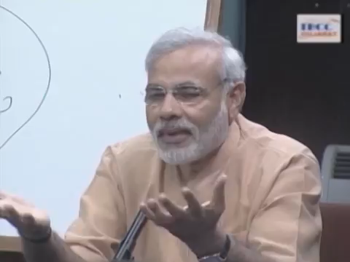
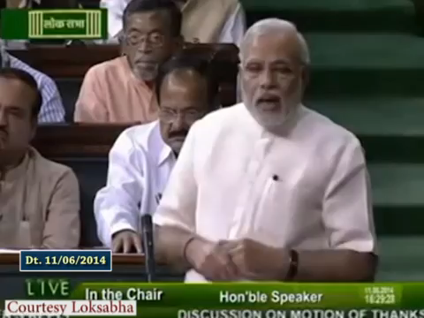
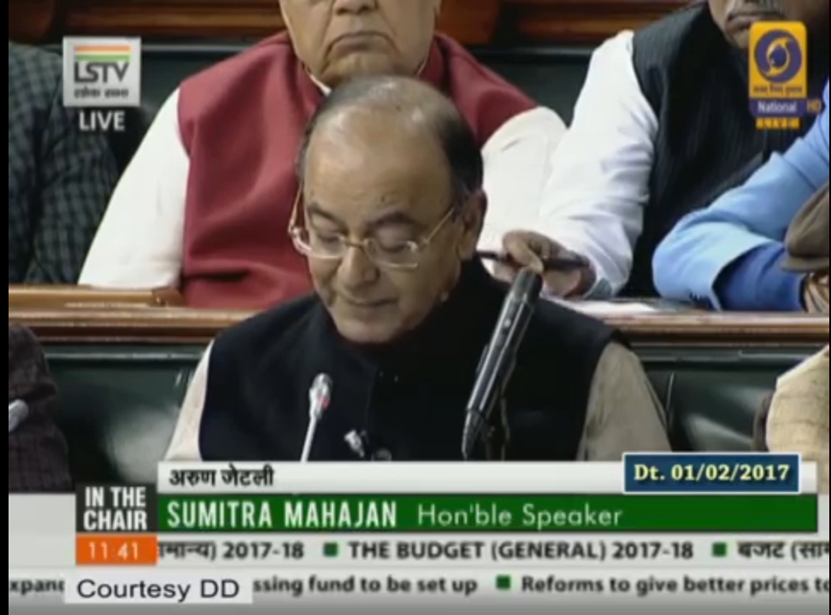
Idea
Learning through Television
Vision
Use of satellite technology for taking high quality education to masses
Vision to Action
Budget Speech 2017
“51. We propose to leverage information technology and launch SWAYAM platform with at least 350 online courses. This would enable students to virtually attend the courses taught by the best faculty; access high quality reading resources; participate in discussion forums; take tests and earn academic grades. Access to SWAYAM would be widened by linkage with DTH channels, dedicated to education”.

Slide 3
About SWAYAM-PRABHA
Free DTH Channel for Education
Use of satellite technology for taking High quality education to the masses.
32 DTH channels devoted to telecasting of high-quality educational programs on 24X7 basis using the GSAT-15 satellite.
Each channel has 4 hours of fresh contents every day which is repeated 5 more times to facilitate viewing as per convenience.
Contents are curriculum based at Graduate and Post-Graduate levels covered in structured manner.
The lectures are by best teachers from premier institutions in the country.
Covers all disciplines - Engineering, Science, Humanities, Commerce etc
4 IIT PAL channels in Mathematic, Physics, Chemistry and Biology to assist class 11 and 12 students prepare for competitive exams like IIT JEE

Slide 4






Objectives
Free DTH Channel for Education
Equal Access
Higher Education
Higher Education
Equal access to high quality education
School education
Curriculum-based courses
School Education
Curriculum based graduate and post graduate contents
Live Classes
Competitive Exam Preparation
live transmission of educational events
Assist students prepare for competitive exams

Slide 5




Partners
Free DTH Channel for Education
BISAG
Dept of Space
M/s Electronics Corporation of India Limited (ECIL) and Bhaskaracharya Institute for Space Applications and Geo-Informatics (BISAG) set up the Uplinking station at BISAG
Department of Space allocated two transponders in GSAT-15
Content (NPTEL, IITs, UGC, CEC,
IGNOU, NCERT, NIOS)
INFLIBNET
Portal for Programme schedule and video archival.
Content Providers: 4 hr of content everyday for each channel

Slide 6





Channel Distribution
Free DTH Channel for Education
NPTEL
(10)
UGC-CEC
(10)
IGNOU
(4)
IIT-PAL
(4)
NCERT
(1)
NIOS
(3)
Engineering Science & Technology
Non- Technology UG-PG Programs
Diploma &
Certificates
Competitive Exam Preparation
School
Programs
Open
Education
Subjects
Subjects
Subjects
Subjects
Subjects
Subjects

Slide 7
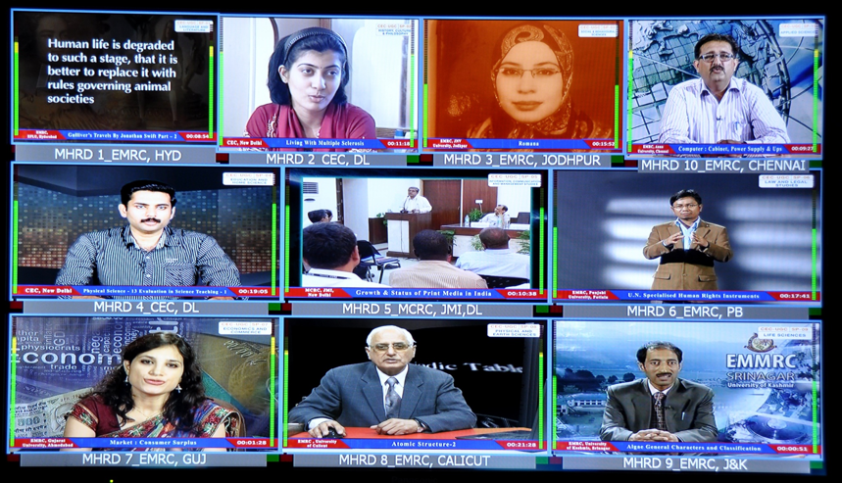
UGC/CEC Channels [UG-PG]
Free DTH Channel for Education
Humanities – I
Language and Literature
6. Social Science – IV
Law, Legal Studies, Human Rights
and related subjects
Humanities – II
Arts, History, Philosophy
and related Subjects
7. Economics, Commerce
and Finance
3. Social Science – I
Sociology, Political Science
and related subjects
8. Physical sciences, Mathematics,
Physics, Chemistry
and related Subjects
4. Social Science – II
Education, Psychology, Home Science
and related subjects
9. Life Sciences, Botany, Zoology,
Bio-Science and related subjects
5. Social Science – III
Management, Library Science,
Information Science and
related subjects
10. Applied Sciences, Allied Physical
and Chemical sciences
and related subjects

Slide 8
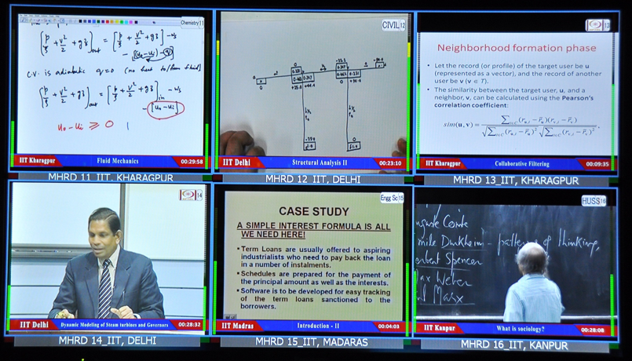
NPTEL Channels
Free DTH Channel for Education
11. Chemical Engineering, Chemistry
nd related Subjects
16. Humanities, Social Sciences
and Management
12. Civil Engineering
and related subjects
17. Mechanical Engineering
and related subjects
13. Computer Science
and Engineering
18. Physics, Metallurgy
and related subjects
14 Electrical engineering, Electronics
& Communication, Engineering
and related subjects
29. Live classes in
Engineering and Technology
15. Engineering Sciences and
general subjects for engg
30. Mathematics

Slide 9
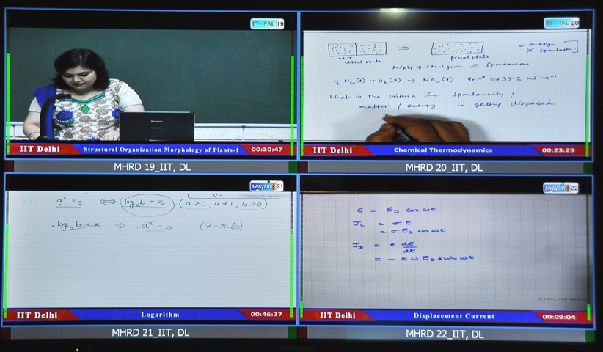
IIT-PAL Channels
Free DTH Channel for Education
19. Biology
20. Chemistry
21. Mathematics
22. Physics

Slide 10
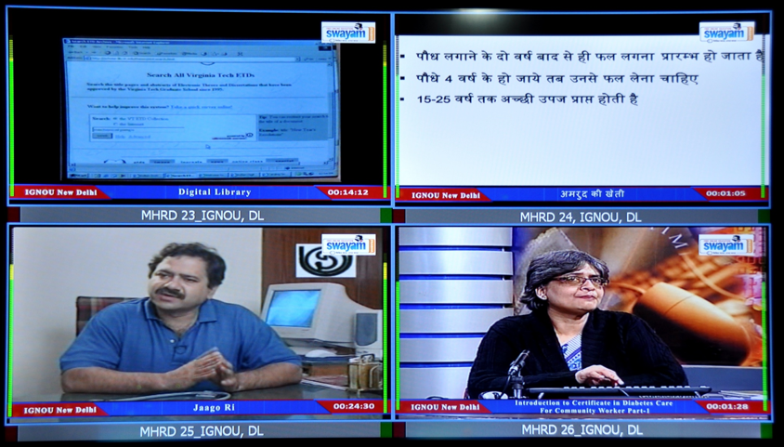
IGNOU Channels
Free DTH Channel for Education
23. Liberal Arts and Humanities
24. Agriculture, Vocational
and Allied Sciences
25. Culture
26. State Open Universities’
programs

Slide 11
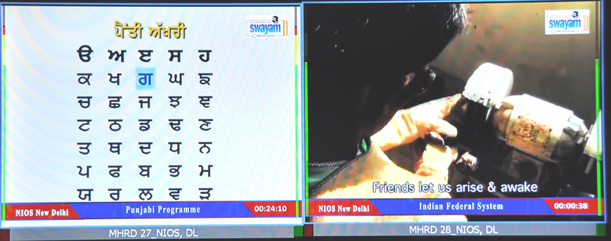
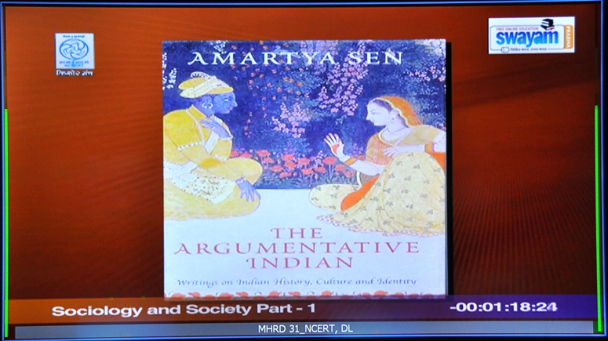
NCERT/NIOS Channels
Free DTH Channel for Education
27. NIOS: Secondary School Education
28. NIOS: Higher Secondary School Education
31. NCERT: School and Teacher Education
32. NIOS & IGNOU : Teacher Education

Slide 12
Portal Features
Free DTH Channel for Education
Programme Schedule
Archival Videos
Feedback Mechanism
Search & Browse Interface

Slide 13
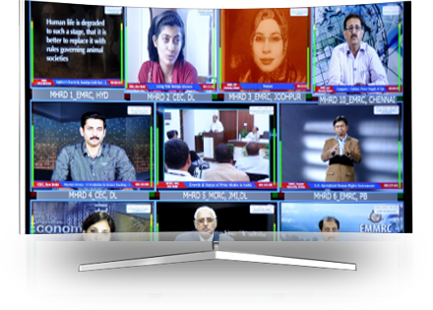


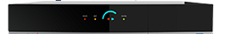
How to Receive Swayam-Prabha Channels
The receive system contains three units:
01
One small sized DTH Dish Antenna along with LNBF (Low Noise Block-down convertor Feedhorn)
03
Remote control unit for STB
02
Indoor Set-Top-Box (STB)
The subscribers of ‘Free Dish’, DTH service of Doordarshan, can view these Educational channels using the same Set Top Box and TV. No additional investment is required.

Slide 14
Technical Parameters
Technical Parameters for Installation and configuration of the system
Satellite – GSAT-15 from ISRO,
Orbital location – 93.5 East, Ku- Band
Receive parameters
Channel 1 to 16
Channel 16 to 32
    Receive frequency - 11590 MHz
    Symbol rate - 29500 Ksps
    Polarization - Vertical
    FEC - ¾
    Receive frequency - 11670 MHz
    Symbol rate - 29500 Ksps
    Polarization - Vertical
    FEC - ¾

Slide 15
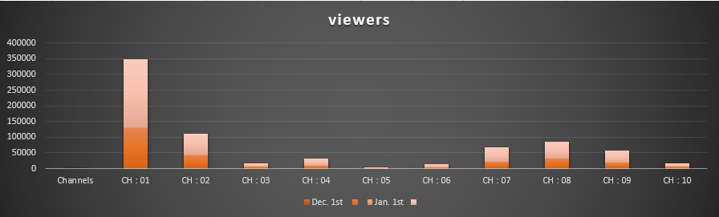
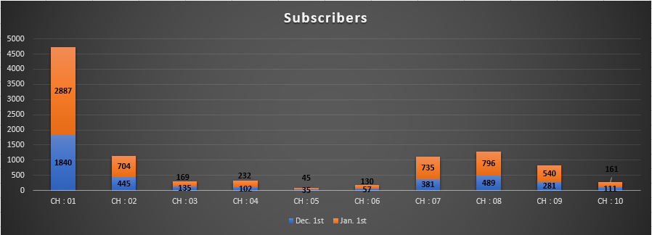
Viewers and Subscribers: UG-PG Non technology

Slide 16
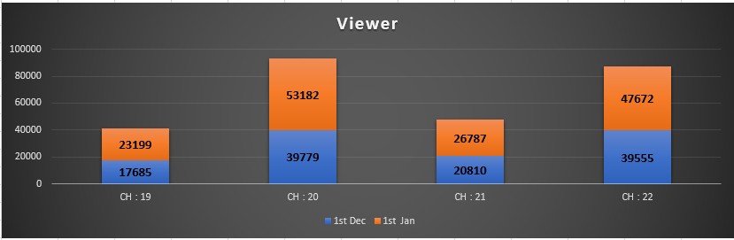
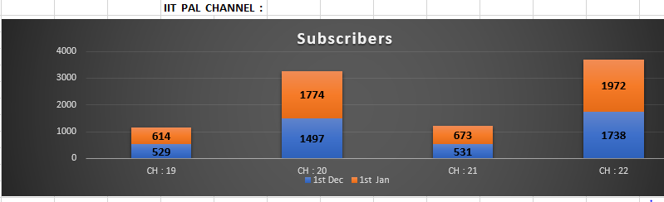
Viewers and Subscribers: IIT-PAL

Slide 17
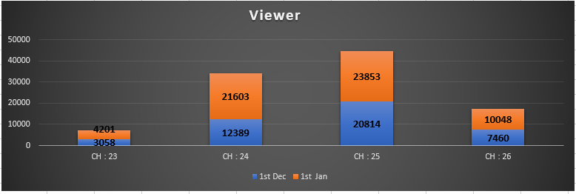
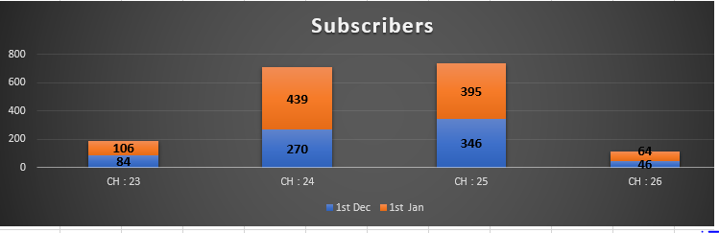
Viewers and Subscribers: IGNOU Channel

Slide 18
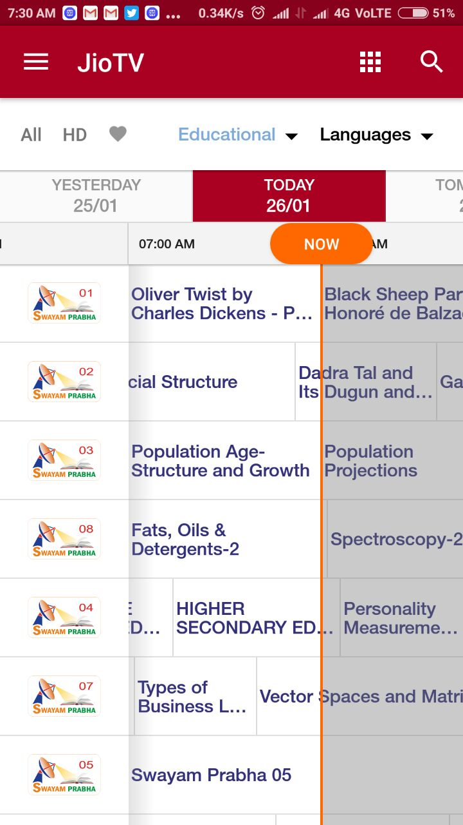
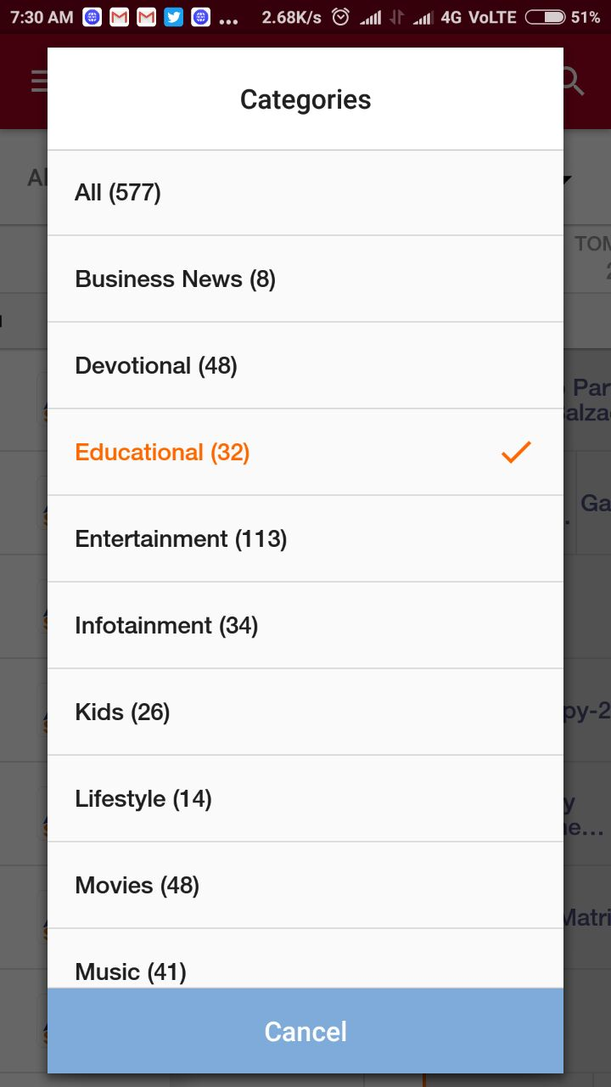
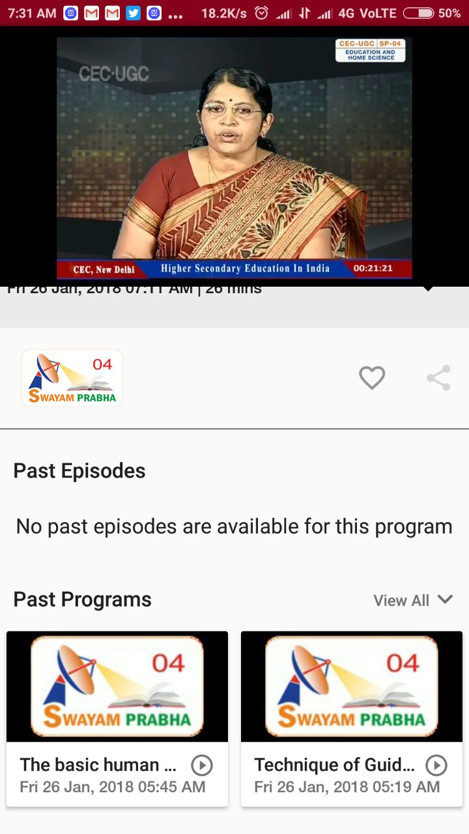

Slide 19
Thank you
We welcome your views and suggestions.
Receive parameters
Channel 1 to 16
Parameswaran.N
Senior Consultant
MHRD
param.sc@nmeict.ac.in
Abhishek Kumar
Scientist
INFLIBNET Centre
abhishek@inflibnet.ac.in

