Slide 1
Orientation Workshop for Swayam Coordinators
e-PG Pathshala, MOOCs,
UGC Regulations & its Adoption.
Dr (Mrs) Pankaj Mittal
Additional Secretary, UGC
(Former Vice Chancellor,
BPS Women University)
February 2, 2018

Slide 2

Information flow and Media Consumption Habits

Slide 3










E-content development under E-PGP
Developing e-content in 77 subjects
Team-work
1 Subject = 16 Paper*
1 Paper = 30-35 Module (20 Hr lecture)
Total module = 16 X 35 = 560
Principal Investigator
(1)
Pool of CR/LE
Paper Coordinator
(16)
CR
Four Quadrant approach
LE
Each Module comprises of
e-text = textual material
Self- learning = audio / video component
Self assessment = Questions
Learn More = further reference material
Team of Authors/
Content Writers
* 4 core paper of each semester (2Yr course)

Slide 4


Methodology to develop & Host e-Content
Multimedia Team
UGC, PI & Anchor Institute (MOA)
Principal Investigator
Paper Coordinators(16)
Content Reviewers / Language Editors
Hosted
ePGP site@INFLIBNET
Content Writers

Slide 5


Present Status of e-PG Pathshala
Videos/e-text available on e-PG Pathshala web
18,000+
Visitors on e-PG Pathshala (Globally)
33 lakh+
E-content of e-PG Pathshala used for developing MOOCs on SWAYAM and for telecasting videos on 10 DTH Channels under Swayam Prabha project

Slide 6
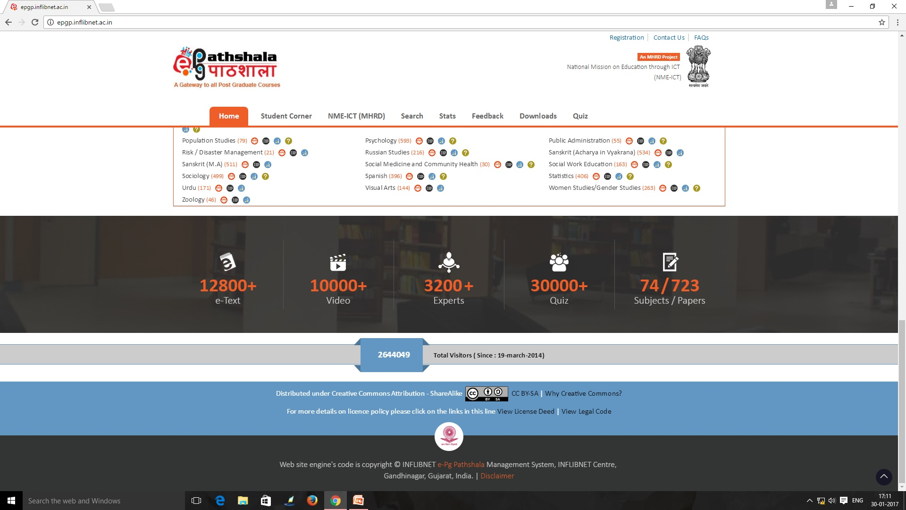
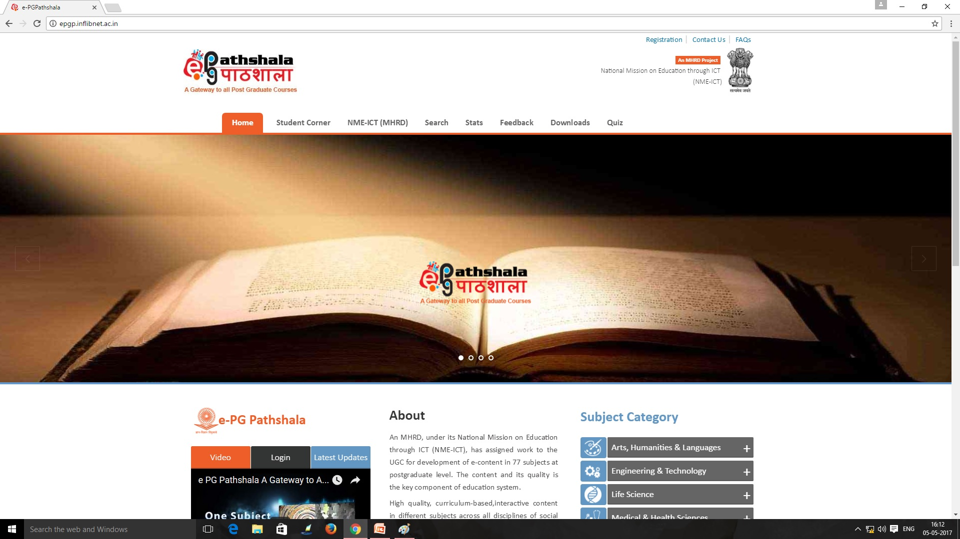

Slide 7
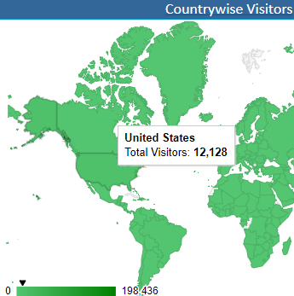
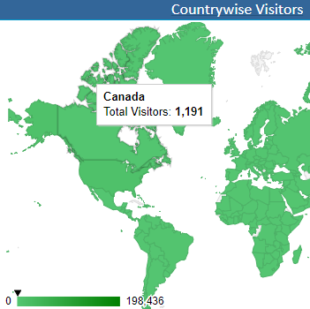
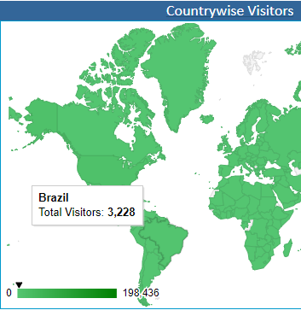
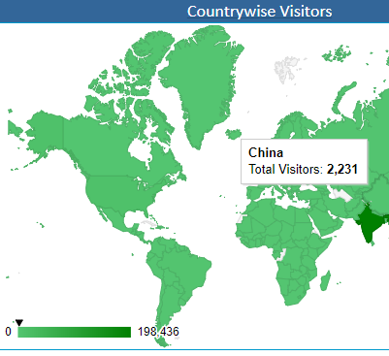
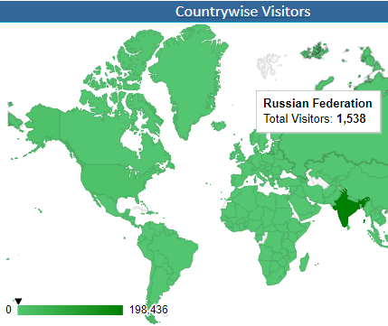
Impact Analysis of e-PG Pathshala
e- Content is available in open access at www.epgp.inflibnet.ac.in
International visitors – 12128+ from USA, 3228+ from Brazil, 2231+from China, 1191+ from Canada and 1538+ from Russian federation)
Total visitors - 33.63lakh (as on 15th January, 2018)

Slide 8
MOOCs - A different educational space
Boundary less Institute / University
Massive – Large enrolment numbers
Open - No mandatory qualifications – Open to all
Online – Fully online
Course - Structured course content
is an online course aimed at unlimited participation and open access via the web.
The basic philosophy of MOOCs is 3A’s i.e., Anytime, Anyone, Anywhere.

Slide 9
NATIONAL COORDINATORS
National MOOCs Coordinator | Sectors
University Grants Commission (UGC) | Non-Technology Post Graduate Degree Programs
NPTEL | Technical/Engineering UG & PG degree programs
Consortium for Educational Communication (An IUC of UGC) | Non-Technology Under Graduate degree programs.
IGNOU | Diplomas and Certificates
NCERT | School Education from Class 9th to 12th.
NIOS | School Education from Class 9th to 12th.
IIM Bangalore | Management programs.
NITTR, Chennai | Teacher Training programs.

Slide 10
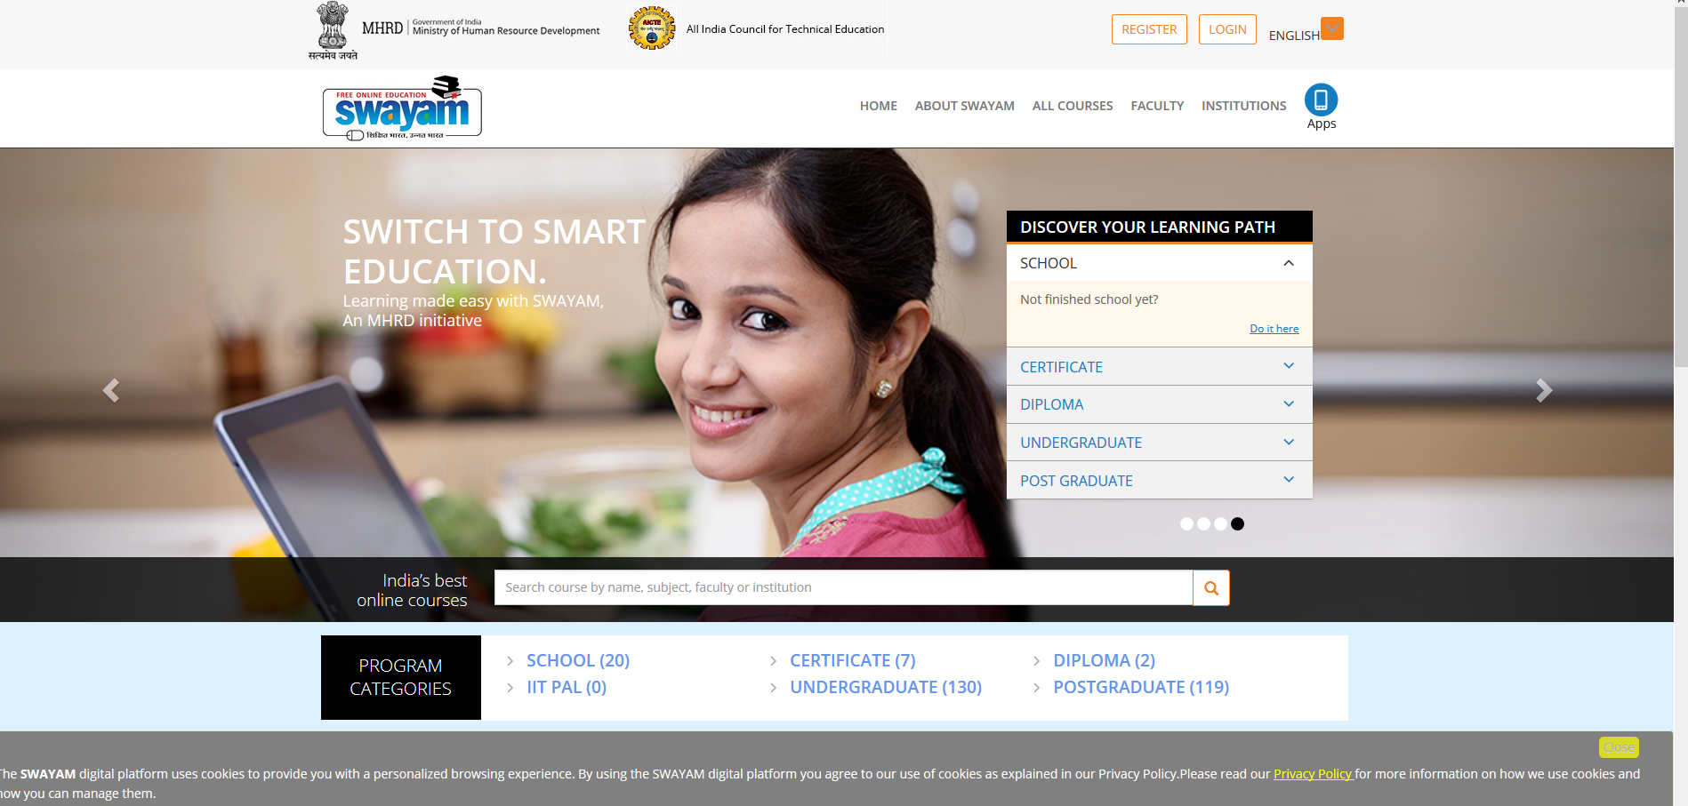

Slide 11
Difference between e-content and MOOCs
E-PG Pathshala
(OER)
MOOCs
MOOCs has teacher-student groups where MOOC coordinator/teacher interacts with the learner. A learner can earn certificate/credit on successful completion of MOOCs course on SWAYAM.
E-PG Pathshala provides e-content in four quadrants. It can be accessed as Open Educational Resource (OER) where no teacher support/hand-holding for students is available.

Slide 12
Development of MOOCs
Two methods followed:
  Repurposed from e PGP (63 uploaded on Swayam, 100 in pipe-line)
  New MOOCs to be developed (100 in first year)
New MOOCs may be offered for - courses high in demand but expertise not available in majority of the universities (eg Electives). (Suggestions solicited from academia, students on UGC Website)
  For core and generic papers, e-PG Pathshala to be used as OER
.

Slide 13



UGC (Credit Framework for Online Learning Courses through SWAYAM) Regulation, 2016
Issued on 19th July 2016
Learning Courses
Notification
Online learning courses to be available on SWAYAM
SWAYAM to notify courses on June 1 & Nov 1, every year
Credit Transfer
Choice of Courses
Up to 20% courses in a Program can be on SWAYAM
Courses on SWAYAM permitted for credit transfer

Slide 14




Step by step procedure to be adopted by Universities for adopting MOOCs on SWAYAM
Step-1: Make Amendments
Step-2: Select the Courses
The University through their Competent Authority (EC, AC, BOS), should make amendments in their Ordinances, Rules, Regulations to incorporate provisions for transfer of credits for MOOCs courses as per UGC Regulations.
The University shall select the courses to be permitted for credit transfer through SWAYAM. (eg courses in high demand for which faculty is not available, elective courses or for supplementing teaching-learning process) while ensuring that physical facilities like laboratories, computer facilities, library etc. required for the course are made available free to the students in adequate measure.
Step-3: Designate Course Coordinator
The University must designate a Course Coordinator/facilitator to guide the students throughout the course and to facilitate/conduct the Lab/Practical sessions/examinations.
Step-4: Disseminate Information
The University should widely disseminate information about selected courses to the students through faculty members, notice boards, student forums, workshops and university website etc.

Slide 15




Steps Continued…
Step-5: Course Registration
University to facilitate registration of students. Every student enrolled for the course in the University must register for the MOOCs course.
Step-6: Evaluation
The Host Institution shall evaluate the students registered for MOOCs courses based on discussion forums, quizzes, assignments, sessional and final examinations. The University to assist Host Institution in conducting the final examination.
Step-7: Marks of the Students
The University shall incorporate the marks/grades communicated by the Host Institution in the final mark sheet of the student which counts for award of degree/diploma. However, the University shall evaluate the students for the practical/lab component and incorporate these marks/grades in the overall mark sheet of the student.
Step-8: Certificate
On receipt of MOOCs completion certificate from Host Instt, the University to give equivalent credit weightage upto 20% for the credits earned through SWAYAM. No University shall refuse any student for credit mobility for courses earned through MOOCs.

Slide 16
Outcome of the Project
Addresses the problem of Access, Equity and Quality by addressing faculty shortage and lack of good quality faculty.
The project would help the students and teachers to update their knowledge and skills, especially for those located in rural/backward/remote areas.
The project would successfully bridge the digital divide and would help the nation move towards information-rich society.

Slide 17
Expectations from Swayam Coordinators
Understand and promote the concept in university fraternity
Popularize through Social and other Media – Facebook, Twitter, Whatsapp, emails, posters, jingles, TVC, University Websites.
Identify University Swayam Mentors from Colleges
Disseminate Information received from UGC
Hold workshops and video conferences of affiliated colleges
Facilitate faculty and students to register for courses.
Trouble shooting
Be Partner and Brand Ambassador for Swayam
Advise on change Management

Slide 18
Sample videos
A sample of PG courses produced ........

Slide 19
Thanks for patient hearing
pankajugc@gmail.com

