Slide 1


Steps to be taken by UGC SWAYAM Coordinators for promoting MOOCs on
Dr Diksha Rajput, University Grants Commission, New Delhi

Slide 2
Coverage
The SWAYAM Initiative
Taking the SWAYAM Initiative Forward
Being a SWAYAM Coordinator
Roles and Responsibilities of University Swayam Coordinator(USM) & University Swayam Mentor (USM)
Awareness mechanism
Portal Features

Slide 3

The SWAYAM initiative
Digital platform which gives open access to information, education and learning 2 anywhere, anytime everyone, empowering students of this country
O1
20 percent credit weight age for students opting for courses on SWAYAM
O2
O3
Access to the Best of knowledge, best of teachers
989 courses being offered by 8 National Coordinators and 18,46,098 enrolment on the SWAYAM platform
O4
.
60 MOOCs of UGC are being offered on SWAYAM
O5

Slide 4
UGC recognises the fact that Universities can play a pivotal role in disseminating and popularising the SWAYAM courses amongst its students in particular and the academic fraternity at large, thereby enabling a bigger and wider access to students avail the benefit of MOOCs . UGC needs the support of Universities and their affiliated colleges
to join the SWAYAM revolution.
Taking the
SWAYAM
Initiative
forward
UGC Swayam Coordinators (USC), University Swayam mentors(USM)faculty and students to equally participate and reap the benefits and spread the word among family, friends and acquaintances.

Slide 5
Being a UGC
SWAYAM
Coordinator
You will be the brand
ambassador of SWAYAM for popularising SWAYAM courses
at your University
You will be the Single Point of Contact between UGC MOOCs & your University for SWAYAM
A
B
Most importantly,
you will be a
pillar of support
and an equal partner in promoting the SWAYAM initiative
far and wide with your name & picture on UGC-MOOCS website
D
C
Connecting Link between UGC SWAYAM and students.

Slide 6
Identify University Swayam Mentors (USMs)
Ensure that the students are actively participating in the Course
Take the SWAYAM initiative forward
Clarify their doubts
Roles & Responsibilities
as a UGC SWAYAM
Coordinator (USC)
Encourage more
students across Universities & Colleges to participate in
SWAYAM
Disseminate information about the courses to students
Submitting their Assignments on time

Slide 7

Awareness Initiatives
Awareness workshops in the University and affiliated Colleges
Identify University College Mentors from the faculty as well as student volunteers
Enrol in a course yourself
Make announcements through Posters on notice boards and encourage students/faculty to enrol

Slide 8
Social Media Awareness
Provide a link of e-Pgpathshala, SWAYAM
,Swayamprabha and UGC-MOOCS websiteson your University
Websites and persuade Colleges to do it on their websites
Make announcements through Facebook, Twitter, Linkedin by creating University SWAYAM profiles
Send Press Releases
TVCs on local channels and Radio Jingles on local FM radio

Slide 9
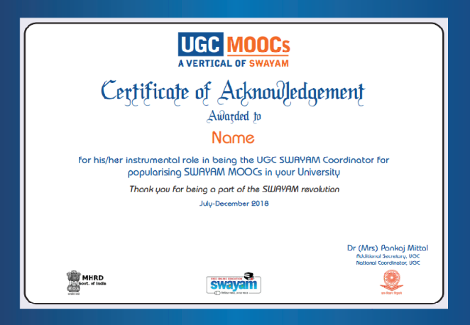

Recognising the contribution of SWAYAM Coordinators & Mentors
A page for every UGC SWAYAM Coordinator (USC) to be created on the UGC MOOCs website.
Swayam Coordinators & mentors to be awarded certificates of appreciation for their active participation.

Slide 10
UGC-MOOCs Portal Features
Information about all PG non-technology courses
Interface for MOOCs Courses (EoI & Proposal)
Guidelines (MOOCs, Regulations, Credit Transfer, Content Creation)
Awareness and Workshop
Login features : Dashboard for Coordinators
    Profile creation of USC & their USMs
    Registration details of learners
    MOOCs to be taken/ approach
    Communication between USC & USMs
    Discussion Forums

Slide 11
Thank You…

